Slide 1



Interactive dashboard with SOLR and HUE
Workshop 2-6 Ex 5
Raja Srikar Karthik Chinta
Naveen Kumar Puvvada
Lakshman Pavan Kumar Vudutha

Slide 2
Naveen Kumar Puvvada
Solr is an open source enterprise search platform, written in Java, from the Apache Lucene project.
Its major features include full-text search, hit highlighting, faceted search, real-time indexing, dynamic clustering, database integration, NoSQL features and rich document (e.g., Word, PDF) handling.

Slide 3
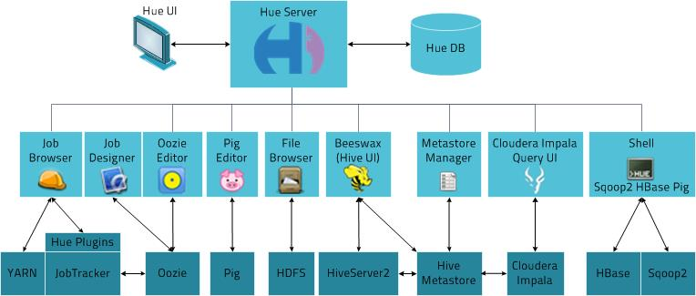
Naveen Kumar Puvvada
Hue is an open source Query Tool for browsing, querying and visualizing data with focus on SQL and Search.

Slide 4
Naveen Kumar Puvvada
Features
Editors for Hive, Impala, Pig, MapReduce, Spark and any SQL like MySQL, Oracle, SparkSQL, Solr SQL, Phoenix and more.
Dashboards to dynamically interact and visualize data with Solr or SQL.
Scheduler of jobs and workflows.
Browsers for Jobs, HDFS, S3 files, SQL Tables, Indexes, Git files, Sentry permissions, Sqoop and more.

Slide 5
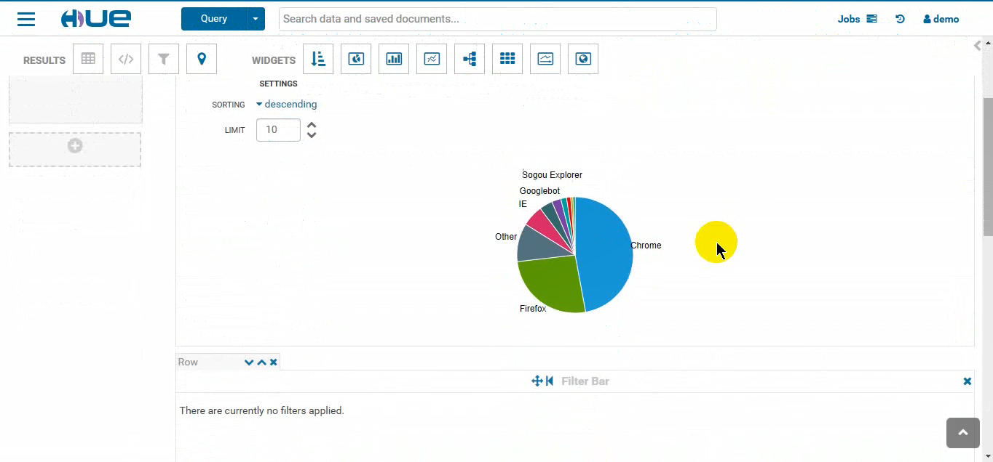
Dashboard
Naveen Kumar Puvvada
Pie Chart

Slide 6
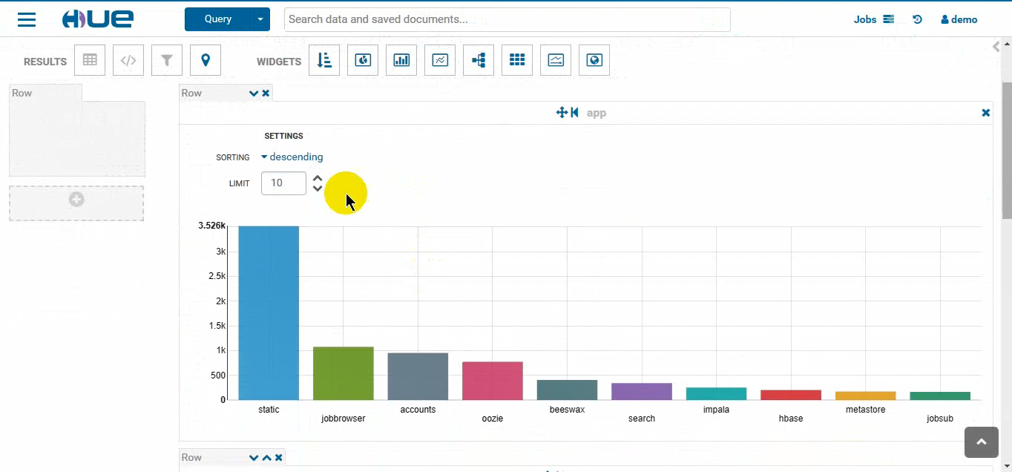
Dashboard
Pavan Kumar Vudutha
Bar Chart

Slide 7
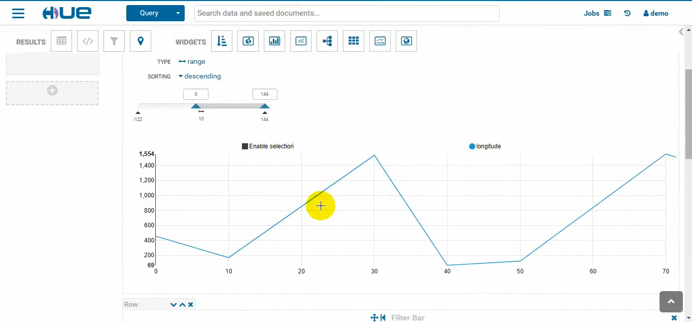
Dashboard
Pavan Kumar Vudutha
Line Chart

Slide 8
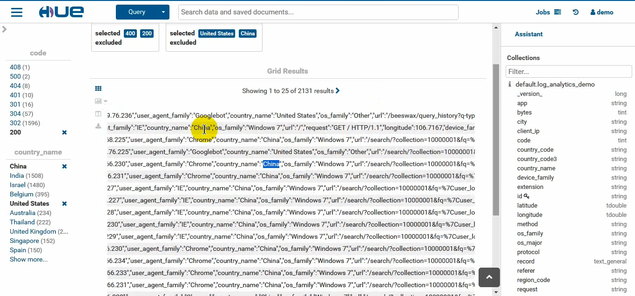
Dashboard
Pavan Kumar Vudutha
Facets

Slide 9
Demo
with
Raja Srikar Karthik Chinta

Slide 10
Summary
We have discussed briefly what solr is and how powerful the non SQL search engine is when it falls into clients hand.
We can create required dashboards in hue in a colorful and customized way.
We can embed various widgets in creating a dashboard as shown in our demo.
Raja Srikar Karthik Chinta

Slide 11
References
https://www.cloudera.com/developers/get-started-with-hadoop-tutorial/exercise-5.html
http://gethue.com/hadoop-search-dynamic-search-dashboards-with-solr/
https://en.wikipedia.org/wiki/Apache_Solr
https://training-course-material.com/index.php?title=CCAH&action=slide
http://gethue.com/search-dashboards/
https://github.com/crskarthik/Hue_Dashboards_Presentation

Slide 12


Slide 13


